Slide 1
BATCH NO: 2

Slide 2

BUILDING A SECURE AND SCALABLE URL SHORTENER WITH FLASK AND SQLALCHEMY
TEAM MEMBERS : B. DEPAKAR,
R. SUDHARSON,
M. VIGNESH
ROLL NUMBER : 732420104002
732420104009
732420104010
GUIDE NAME : Mrs. P. M. MANOCHITRA ME

Slide 3


INTRODUCTION
Welcome to the introduction of our exciting project, BUILDING A SECURE AND SCALABLE URL SHORTENER WITH FLASK AND SQLALCHEMY!.
In this era of rapid information exchange and online communication, we often come across long and cumbersome URLs that are difficult to share effectively. Our URL Shortener project aims to provide a simple yet powerful solution to this problem.

Slide 4
ABSTRACT
The URL Shortener project aims to develop a web-based application that provides users with the ability to shorten long URLs and generate customized, easy-to-share short URLs. This project involves the analysis, design, and implementation of various software modules and components to achieve this functionality.
Helps in efficient handling of URL shortening requests, storage and retrieval of URL mappings, and user management.

Slide 5
ADVANTAGES
Customization options for personalized URLs
Expiration date management for short URLs
User-friendly dashboard for URL management and analytics
Integration with external services and APIs
Robust database design for efficient URL mapping
Emphasis on security measures and user privacy
Scalable architecture to handle increasing user traffic
Comprehensive testing and quality assurance processes
Support for future enhancements and updates
Compliance with industry standards and best practices

Slide 6
DRAWBACKS
Scalability limitations
Security vulnerabilities
Reliance on external services
User awareness and adoption challenges
Compatibility issues with legacy systems
Maintenance and support requirements
Legal and compliance considerations

Slide 7
USE CASES
Social Media
Marketing and Advertising
Analytics and Tracking
Email Marketing
Mobile Applications
Affiliate Marketing
Internal Systems

Slide 8


EXISTING SYSTEM
Bitly
TinyURL
Ow.ly
Rebrandly
Google URL Shortener (discontinued)
Shorte.st
is.gd
Adf.ly
T2M URL Shortener
Polr
YOURLS

Slide 9
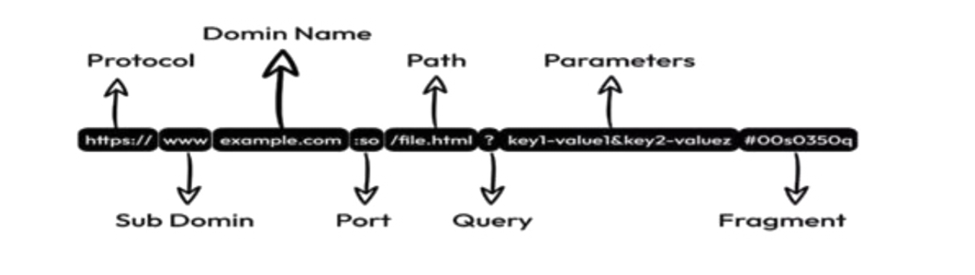
STRUCTURE OF URL
Protocol: Specifies the communication protocol to be used, such as HTTP or HTTPS.
Domain: Identifies the domain name or IP address of the website or server.
Subdomain: Represents a subdivision or specific area within the domain.
Path: Specifies the specific location or directory on the server where the resource is located.
Query Parameters: Contains additional information or data to be passed to the server.
Fragment Identifier: Points to a specific section or anchor within the resource.

Slide 10
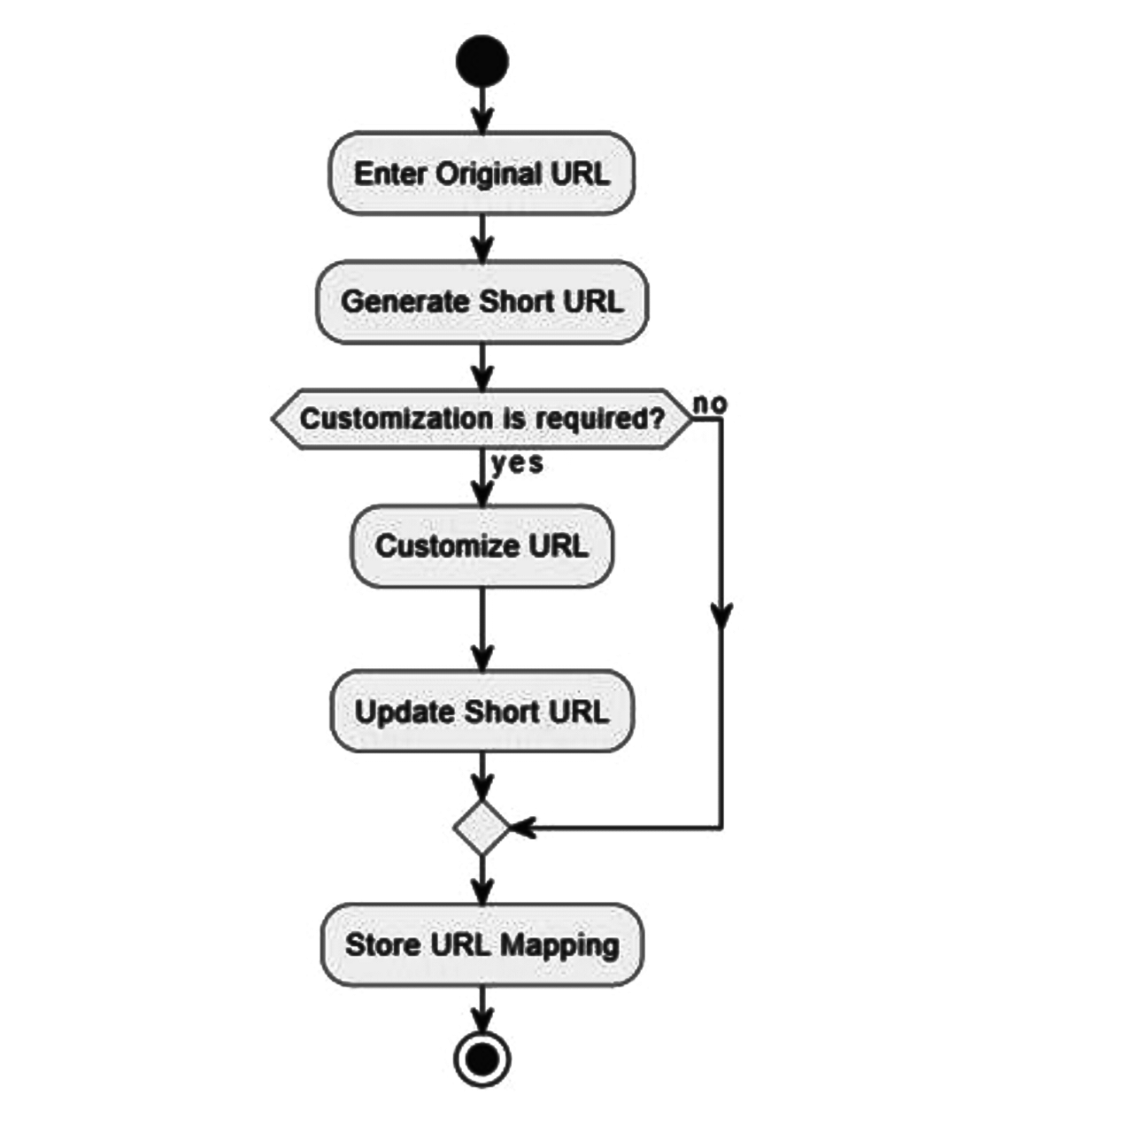
FLOW CHART

Slide 11
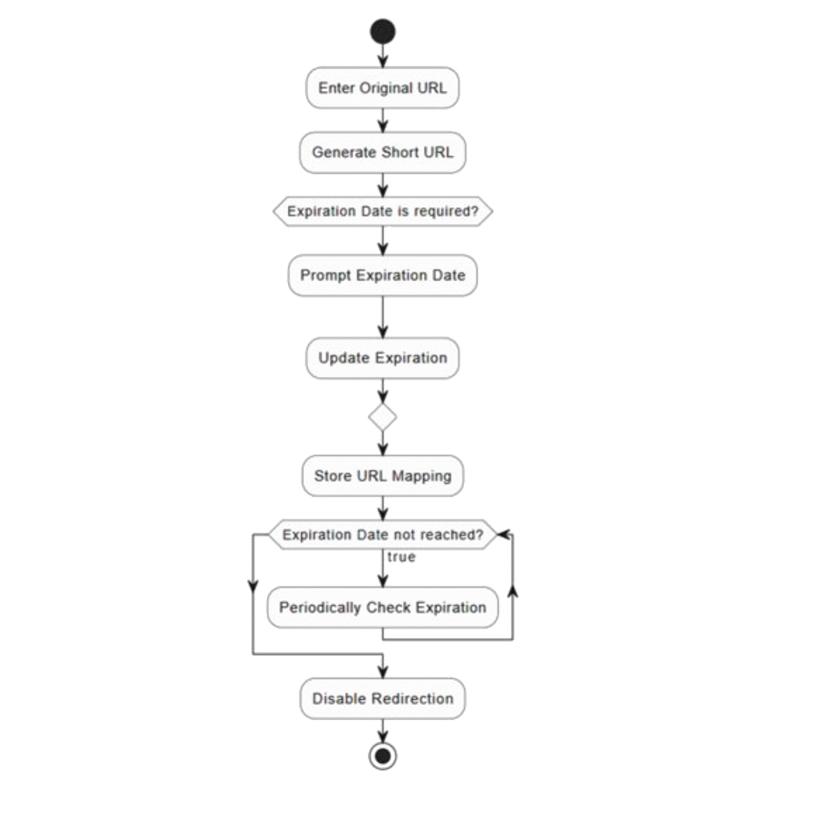
EXPIRATION FLOW CHART

Slide 12
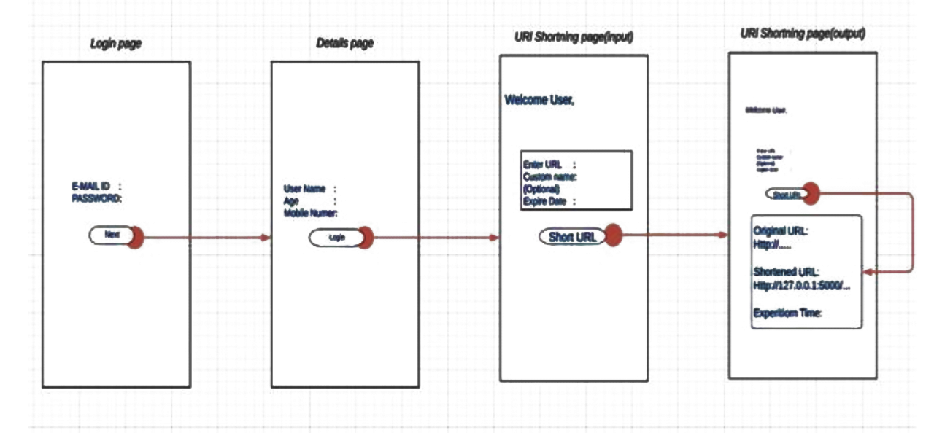
WIRE FRAME

Slide 13


SYSTEM IMPLEMENTATION
1. Backend Development:
Programming Language: Python
Framework: Flask
Database Management System: SQLAlchemy (with PostgreSQL)
2. Frontend Development:
HTML, CSS, and JavaScript
Frontend Framework: Bootstrap
3. Database:
PostgreSQL: A powerful open-source relational database management system

Slide 14


4. Version Control and Collaboration:
Git: A distributed version control system for tracking changes in code
GitHub: A web-based platform for hosting and collaborating on Git repositories
5. Testing and Quality Assurance:
Unit Testing Framework: Pytest
Test Coverage: Coverage.py
Continuous Integration: Jenkins or Travis CI
6. Additional Tools and Libraries:
Templating Engine: Jinja2
JSON Web Tokens (JWT) for user authentication and authorization
Redis for caching purposes
PyLint for code analysis and adherence to coding standards.

Slide 15
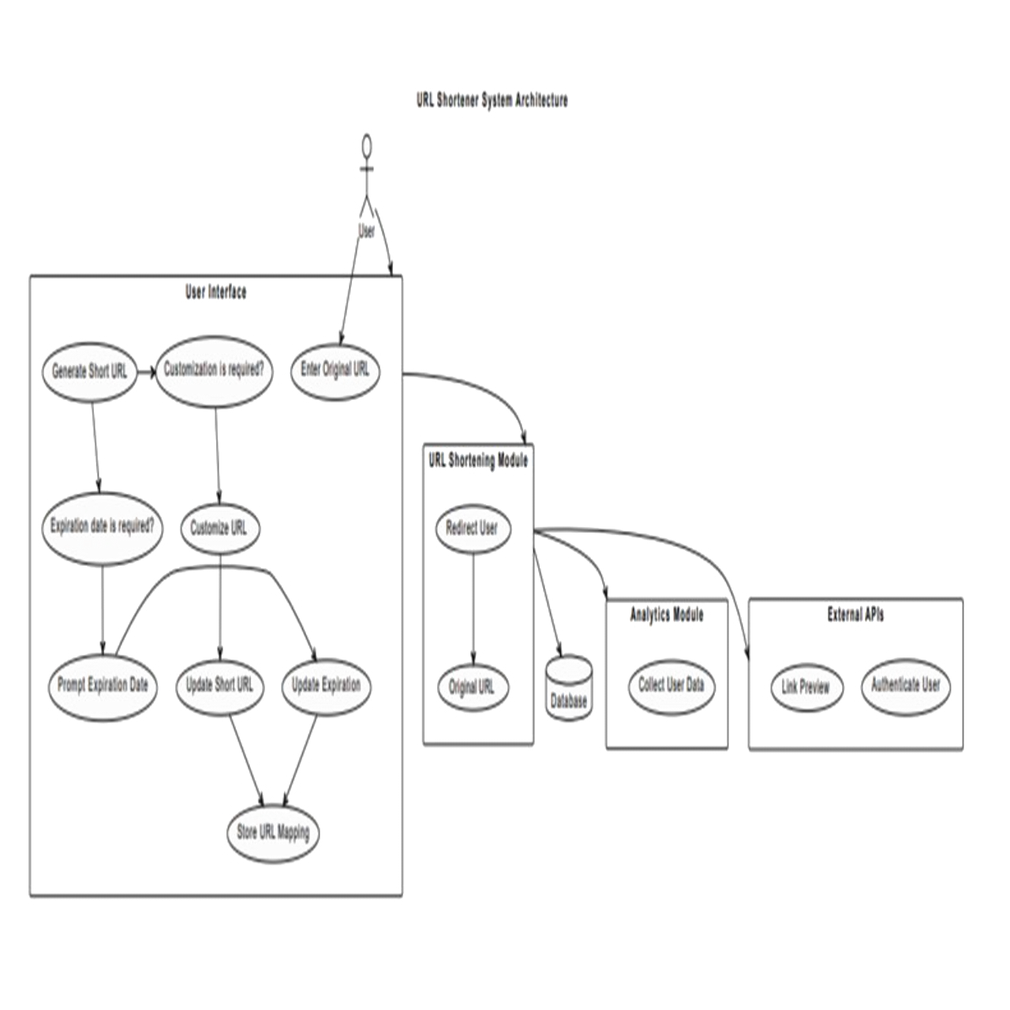
SYSTEM ARCHITECTURE

Slide 16
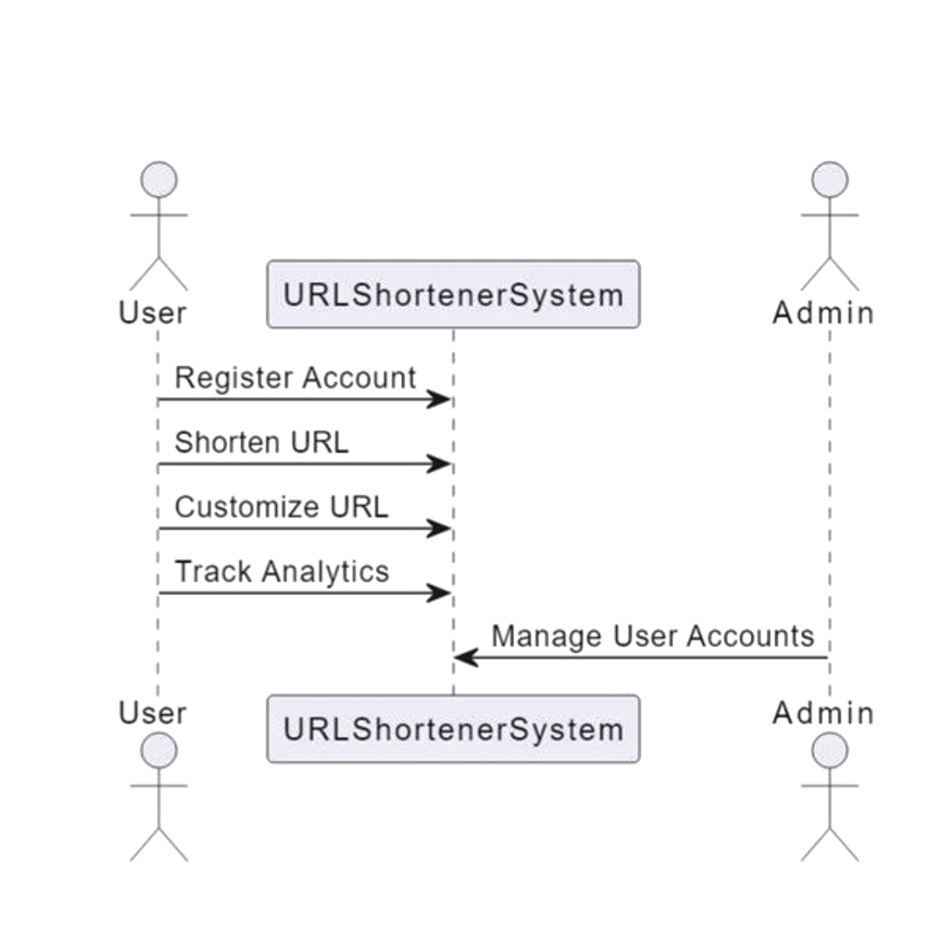
USE CASE DIAGRAM

Slide 17
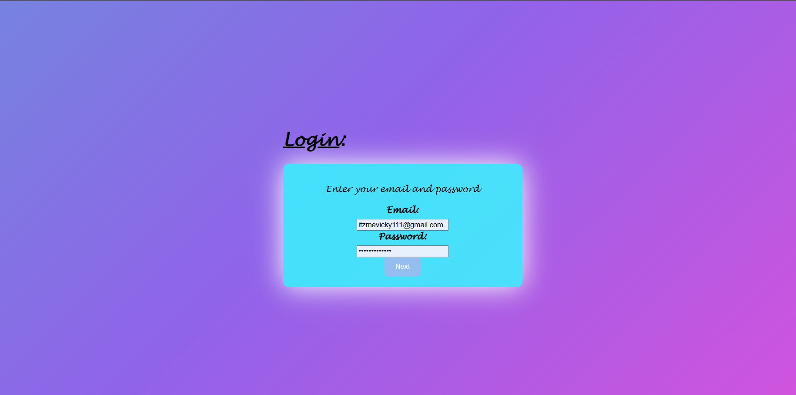
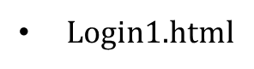
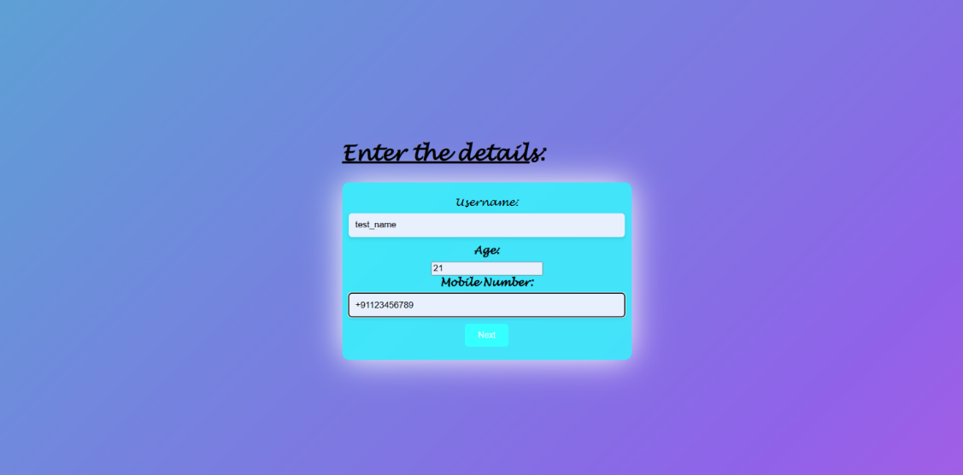
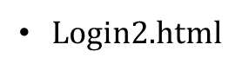
OUTPUT

Slide 18
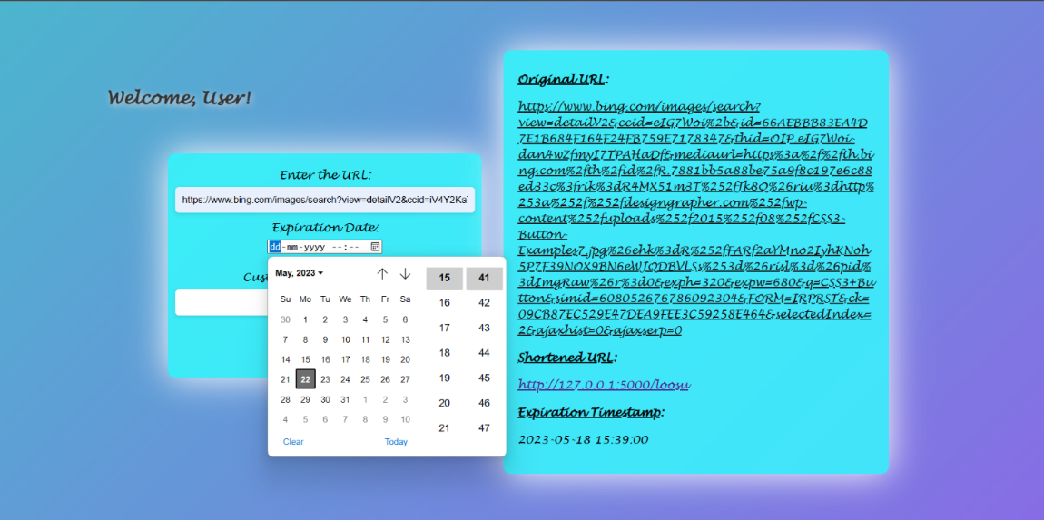
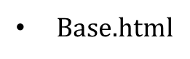
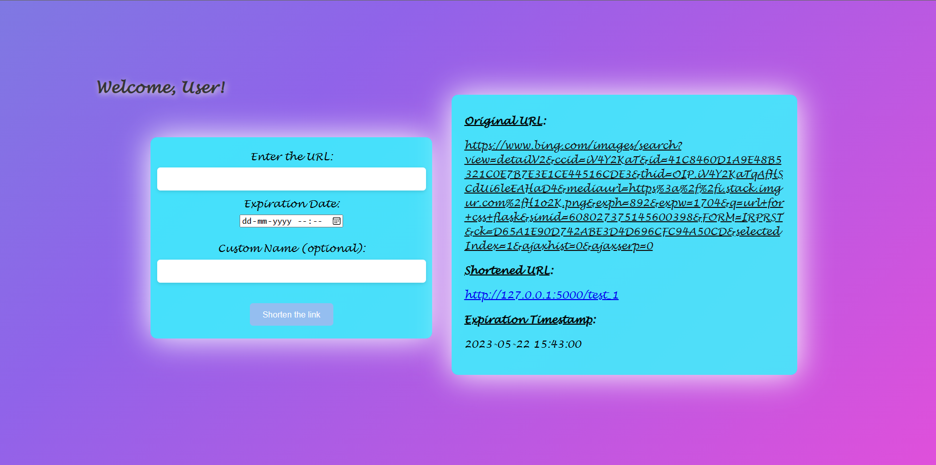
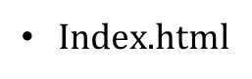

Slide 19
ADVANTAGES OF THIS PROJECT OVER THE EXISTING ONE
Enhanced Customization
URL Expiration Management
Improved User Experience
Reliability and Performance
User-Friendly Interface
Open-Source Nature
Dedicated Support and Community

Slide 20
CONCLUSION
The project BUILDING A SECURE AND SCALABLE URL SHORTENER WITH FLASK AND SQLALCHEMY aims to simplify URL sharing, enhance user experience, and overcome the limitations of existing systems. We are excited to present our innovative solution and demonstrate how it can streamline the way we share and access online content. Thank you for joining us on this journey, and we look forward to showcasing the capabilities of our URL Shortener!

Slide 21

REFERENCE
Flask Web Development, 2nd Edition, By Miguel Grinberg Sept 2020
Building REST APIs with Flask: Create Python Web Services with MySQL, By Kunal Relan July 2022
HTML & CSS: Design and Build Websites, By Jon Duckett Nov 2019
Learn Enough Python to be Dangerous: A Tutorial Introduction to Programming with Python
By Author:Michael Hartl, Publisher:Addison-Wesley Professional • March 2023
Learn Enough HTML, CSS and Layout to Be Dangerous: An Introduction to Modern Website Creation and Templating Systems By Author:Michael Hartl and Author:Lee Donahoe
Publisher:Addison-Wesley Professional • August 2022

Slide 22
THANK YOU 🙂

